Slide 1
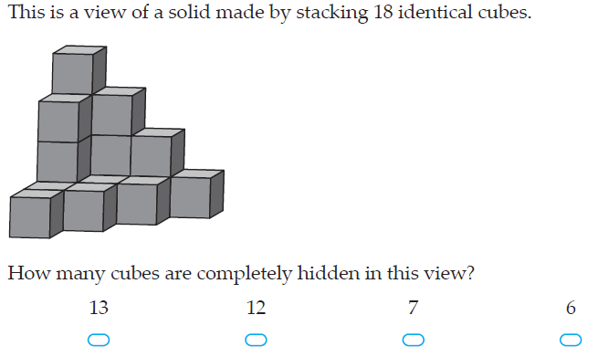
Warm up

Slide 2
Topic: Drawing 3D objects
EQ: How can I draw the different views of a 3D object

Slide 3

https://www.youtube.com/watch?v=xPj2qBLnbi4
Notes:
Get students to watch and draw the examples from the video into their notes

Slide 4
Topic: Drawing 3D objects
EQ: How can I draw the different views of a 3D object
Glue your worksheet here

Slide 5
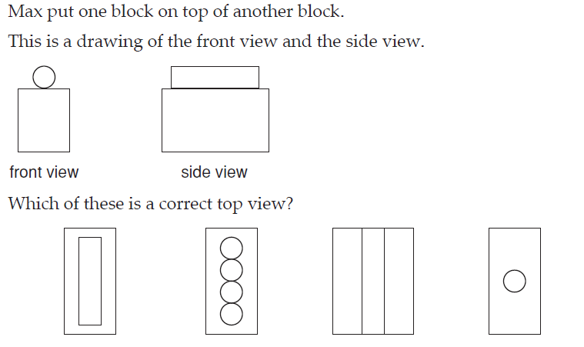

Slide 6
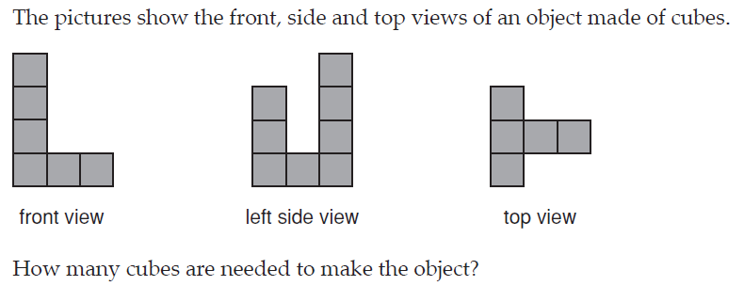

Slide 7
Practice
Complete the worksheet

Slide 8
Summary
Quickwrite
What did you learn today?

